Slide 1
California Road Accident Data Analysis

Slide 2
Project Summary
This Excel dashboard analyzes road accidents in California, focusing on accident trends, vehicle involvement, geographical variations, and severity rates. It helps identify which vehicle types have the highest and lowest accident rates, how accidents vary with population size, and which counties have the most severe cases.
Using pivot tables, bar charts, and trend analysis, the dashboard tracks accident patterns over time and forecasts future incidents. The insights help in suggesting preventive measures like better infrastructure, stricter traffic laws, and public awareness campaigns. This project serves as a valuable tool for policymakers to enhance road safety and reduce accidents in California.

Slide 3
Objectives
Show the number of accidents from different modes of vehicle and from which mode the accidents are highest and lowest ?
How do number of accidents vary with respect to the population ?
How do accident rates vary between different geographical types ?
Which countries in california have the highest and lowest rates of road severity cases ?
How has the frequency of road accidents in california changed over the years ?
What can be the measure steps to be taken to prevent such kind of road accidents by forecasting the accident cases ?

Slide 4
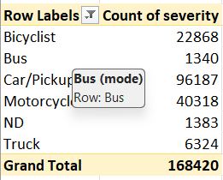
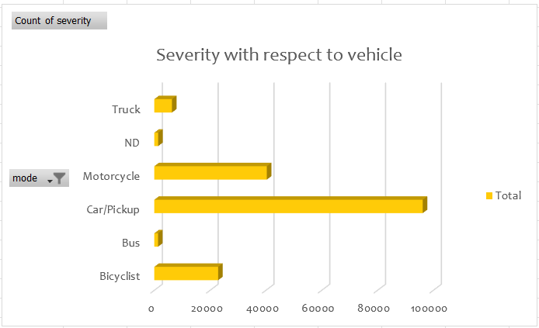
How do number of accidents vary with respect to the population ?
From the given chart it can be identified that there are 168420 cases of severity from all the types of vehicles and highest number of accidents occur from the car/pickup and the lowest occurs from the buses.
Prevention :
1. Investing in road infrastructure to get better signaling, road markings, lighting, and pedestrian crossings can improve the safety for all road users.
2. Equipting the vehicles by advance safety features like ABS , ESC and collision avoiding system.

Slide 5
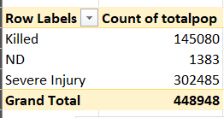
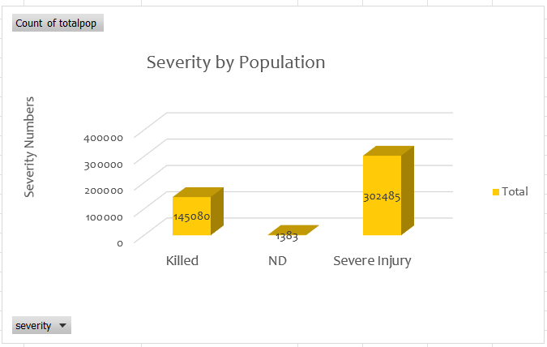
How do number of accidents vary with respect to the population ?
By the graph it is clear that the less population have the death cases and there are severy injuries in higher population .
REASON:
1. The reason of death is that the peoples living in underdeveloped areas might have less facilities to get instant treatment because they are living far from the hospitals and dispencaries.
2.The reason of severe injuries is that the peoples are living in the highly populated areas which are more prone to high traffic but because of urban areas they get treatment instantly.
PREVENTION:
1. There should be infrastructural development in the under developed areas and establishing better communication with the urban areas to insure better facilities for the treatments.
2. In the highly populated areas the government should implement population control policies as well as focus on the better road traffic signals and investing on the safety like equipting vehicles with ABS , collision avoidance systems.

Slide 6
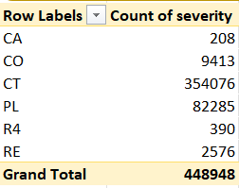
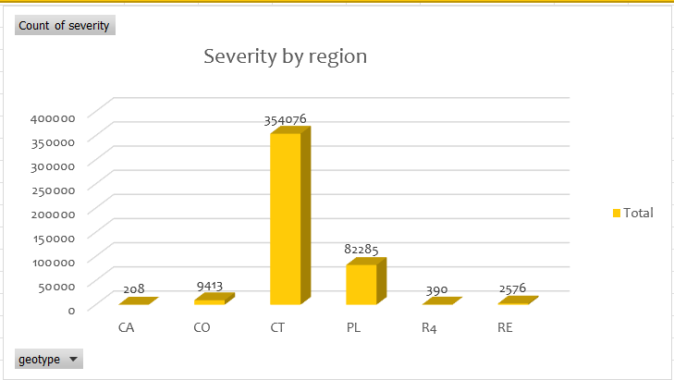
How do accident rates vary between different geographical types ?
This chart explains region wise number of severity/injuries of california from this wet get to know that CT region has the highest rate of severity cases and region CA has the lowest rate of severity cases.

Slide 7
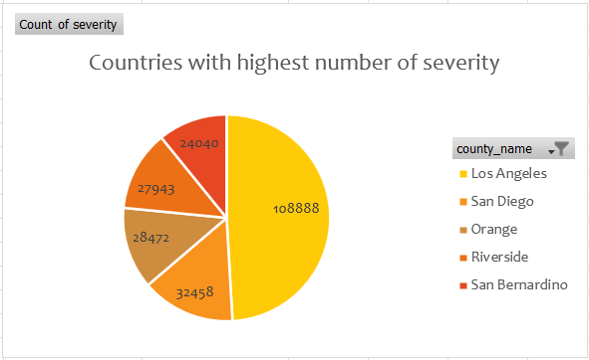
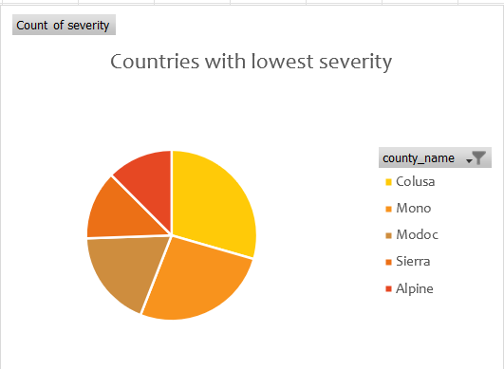
Country with lowest and highest severity
The urban areas are priorly considered as the most cases of accidents to be caused as there is a heavy traffic in urban areas
REASON :
1. Due to heavy population in the urban areas.
2. In the urban areas there are the cases of accidents with drunk and drive .
PREVENTION :
1. Government should implement the population control policies like two child policy .
2. There should be implemented heavy penalty on the peoples who drunk and drive.

Slide 8
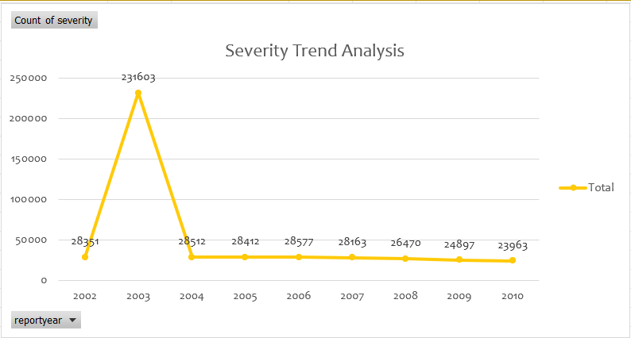
Frequency of road accidents over the different years
Severity Trend Analysis shows the total number of severity over the time period from 2002 to 2010 ,from this we get to know about that there are many cases of accidents in 2003 and in 2010 has the lowest number of accidents.

Slide 9
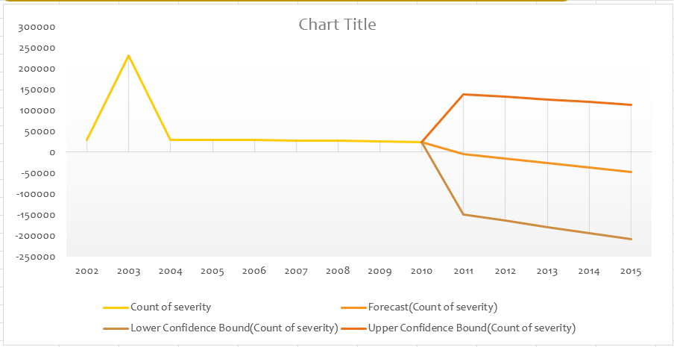
What can be the measure steps to be taken to prevent such kind of road accidents by forecasting the accident cases ?
Prevention:
1. Encouraging the use of public transportation like city buse ,carpooling .
2. Encouraging the use of vehicles equipped with advanced safety features such as
a. Advance braking system braking (ABS)
b.Electronic stability control (ESC)
c. Collision avoidance systems.
3. Investing in road infrastructure to get better signaling, road markings, lighting, and
pedestrian crossings can improve the safety for all road users.

Slide 10
